Slide 1


Fundamentals
Where do I find MATLAB? Here!
Do I have to have MATLAB installed on my computer right now? No, you can use MATLAB Online!

Slide 2

Table of Contents
What we've covered this week in Part 4 Mathematical Functions Arithmetic Operations Introduction to operator precedence Making use of built-in Mathematical Functions What we've covered this week in Part 5
MATLAB Live Script

Slide 3
What we've covered this week in Part 4
This week in Part 4 we learnt about:
Assigning values to variables
Entering commands
The command history
Variables in the base workspace

Slide 4

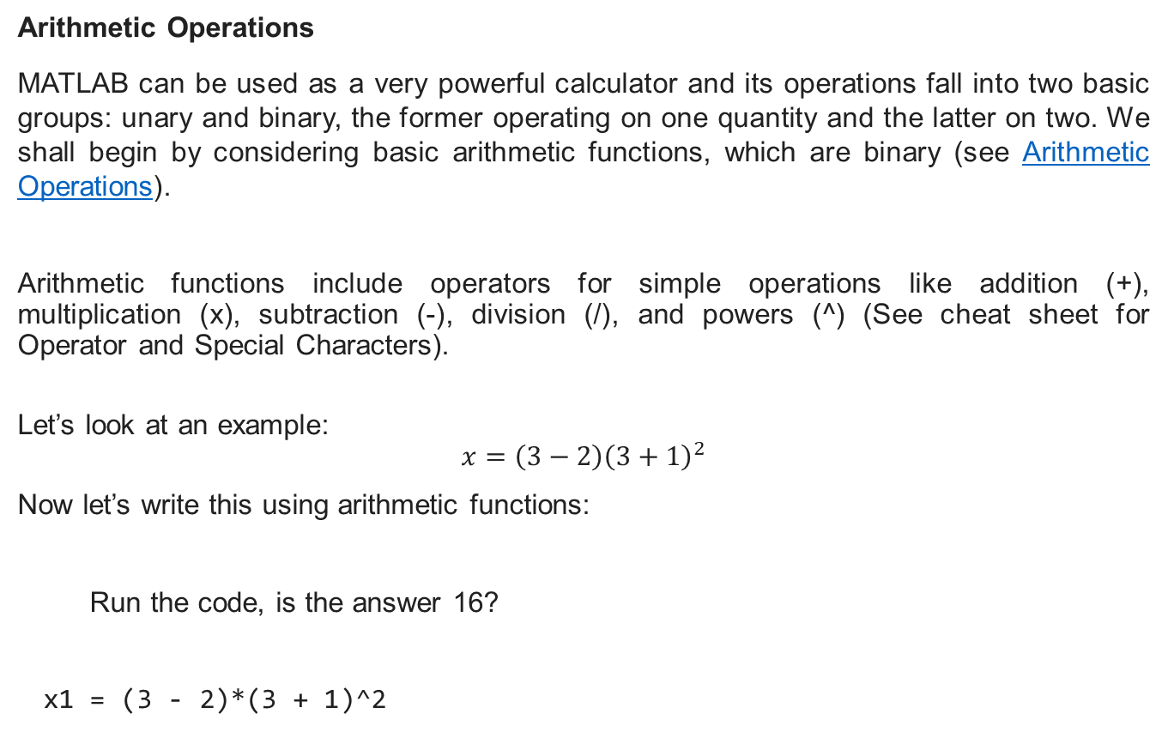
Mathematical Functions
Arithmetic Operations
MATLAB can be used as a very powerful calculator and its operations fall into two basic groups: unary and binary, the former operating on one quantity and the latter on two. We shall begin by considering basic arithmetic functions, which are binary (see Arithmetic Operations).
Arithmetic functions include operators for simple operations like addition (+), multiplication (x), subtraction (-), division (/), and powers (^) (See cheat sheet for Operator and Special Characters).
Let’s look at an example:
$$x=\left(3−2\right){\left(3+1\right)}^{2}$$
Now let’s write this using arithmetic functions:
Run the code, is the answer 16?
x1 = (3 - 2)*(3 + 1)^2

Slide 5


Mathematical Functions
Now you try, write the code for the below equation:
$$x2=\frac{(3−2)(3+1)}{2^{2}}$$
%Insert your code below and check that your answer is 1.
x2 =

Slide 6
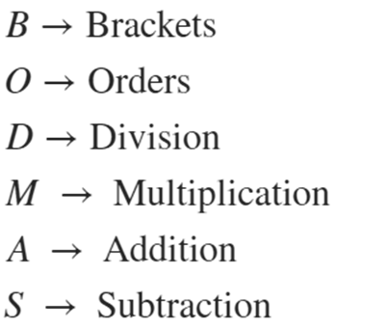
Introduction to operator precedence
Recall BODMAS from high school, which supplied you with a method for approaching calculations. This is a simplified form of Operator Precedence, which is the rule book for how MATLAB executes the calculations/commands you present it with. This precedence and the definitions of these operators will be key in the sections that follow. To get us started, let us refresh our memory on BODMAS:
Let us apply this knowledge by considering the following question.

Slide 7

Introduction to operator precedence
Determine the area of a circle with radius of 5 units.
$$A=πr^{2}$$
A_circle = pi*5^2
The area of a circle with radius of 5 units is $78,54 {units}^{2}$, check that the answers match.

Slide 8
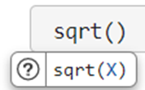
Making use of built-in Mathematical Functions
There are several instances where you might want to leverage built in functions, like the logarithmic, exponential, or trigonometric functions. MATLAB has several built in functions but the ones you are likely to interact with, for now, are these mathematical functions. Once you know which function you would like to use, you can type the function name followed by brackets. MATLAB will automatically show you the expected input for that function. For example, the square root function () is denoted by sqrt and MATLAB automatically supplies the user with the in-line pop-up sqrt(x) showing that this function expects a single input:
You can click on the help icon, , if you need more information on the function and how to use it. You can also right-click on the function and go to Help to open the related documentation page. Let us try use one of the built-in functions by considering the following question.

Slide 9
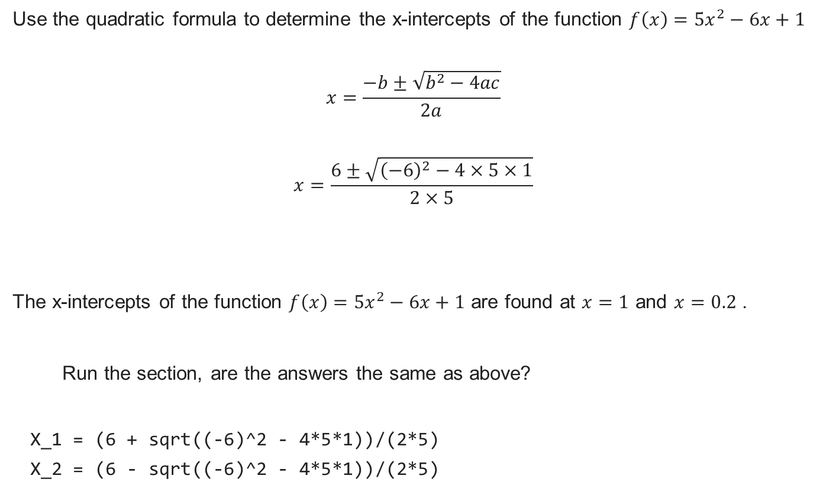
Making use of built-in Mathematical Functions
Use the quadratic formula to determine the x-intercepts of the function $f\left(x\right)=5x^{2}−6x+1$
$$x=\frac{−b±\sqrt{b^{2}−4ac}}{2a}$$
$$x=\frac{6±\sqrt{{\left(−6\right)}^{2}−4×5×1}}{2×5}$$
The x-intercepts of the function $f\left(x\right)=5x^{2}−6x+1$ are found at $x=1$ and $x=0.2$ .
Run the section, are the answers the same as above?
X_1 = (6 + sqrt((-6)^2 - 4*5*1))/(2*5)
X_2 = (6 - sqrt((-6)^2 - 4*5*1))/(2*5)

Slide 10
What we've covered this week in Part 5
This week in Part 5 we learnt about:
Arithmetic operations
Introduction to operator precedence
Making use of built-in Mathematical Functions

Slide 11
MATLAB Live Script
Click on the link below for this lecture’s MATLAB live Script
Week_1_Part_5_Fundamentals.mlx
Copyright 2022 The MathWorks, Inc. & Opti-Num Solutions (Pty) Ltd.

